Slide 1
Spark (Apache Spark)

Slide 2
Why Spark?
Apache Spark was developed to overcome the limitations of Hadoop MapReduce cluster computing paradigm. Some of the drawbacks of Hadoop MapReduce are:
Use only Java for application building.
Since the maximum framework is written in Java there is some security concern. Java being heavily exploited by cybercriminals this may result in numerous security breaches.
Opt only for batch processing. Does not support stream processing.
Hadoop MapReduce uses disk-based processing. Due to these weaknesses of Hadoop MapReduce ,Apache Spark come into the picture

Slide 3
Features of Apache Spark
Swift Processing The key feature required for Bigdata evaluation is speed. With Apache Spark, we get swift processing speed of up to 100x faster in memory and 10x faster than Hadoop even when running on disk. It is achieved by reducing the number of read-write to disk.
Dynamic Because of 80 high-level operators present in Apache Spark, it makes it possible to develop parallel applications. Scala being defaulted language for Spark. We can also work with Java, Python, R. Hence, it provides dynamicity and overcomes the limitation of Hadoop MapReduce that it can build applications only in java.
In – Memory Processing Disk seeks is becoming very costly with increasing volumes of data. Reading terabytes to petabytes of data from disk and writing back to disk, again and again, is not acceptable. Hence in-memory processing in Spark works as a boon to increasing the processing speed. Spark keeps data in memory for faster access. Keeping data in servers’ RAM as it makes accessing stored data quickly /faster.

Slide 4
Features of Apache Spark
Fault Tolerance Spark RDD (Resilient Distributed Dataset), abstraction are designed to seamlessly handle failures of any worker nodes in the cluster. Thus, the loss of data and information is negligible.
Real-Time Stream Processing Spark Streaming can handle real-time stream processing along with the integration of other frameworks which concludes that sparks streaming ability are easy, fault tolerance and Integrated.
Compatibility with Hadoop & existing Hadoop Data Apache Spark is compatible with both versions of Hadoop ecosystem. Be it YARN (Yet Another Resource Negotiator) or SIMR (Spark in MapReduce). It can read anything existing Hadoop data that’s what makes it suitable for migration of pure Hadoop applications. It can run independently too

Slide 5
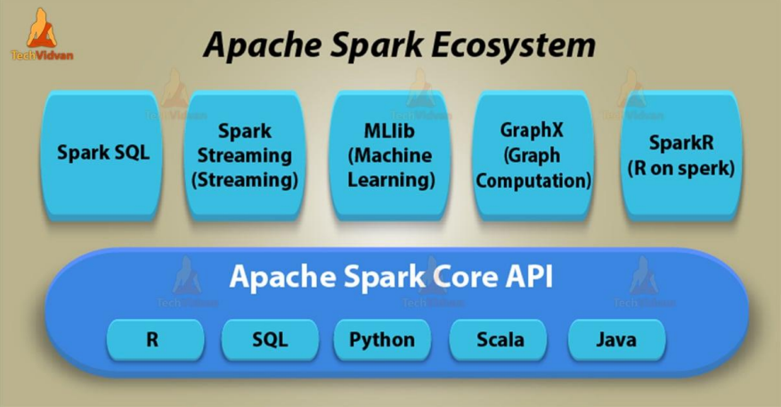
Spark Ecosystem

Slide 6
Spark Ecosystem
Spark Core:
Spark Core is the foundational component of the Spark ecosystem that provides distributed task dispatching, scheduling, and basic I/O functionalities. It also includes resilient distributed datasets (RDDs), which are the fundamental data structure in Spark for parallel computation.
Spark SQL:
Spark SQL provides a DataFrame API and SQL interface for working with structured and semi-structured data. It allows developers to perform SQL queries, join datasets, and integrate with external databases and data sources seamlessly.
Notes:
RDDs are an immutable, distributed collection of objects that are partitioned across nodes in a cluster and can be operated on in parallel

Slide 7
Spark Ecosystem
Spark Streaming:
Spark Streaming enables scalable, fault-tolerant stream processing of live data streams. It integrates with Spark Core, allowing developers to apply the same RDD transformations and actions on continuous streams of data.
MLlib (Machine Learning Library):
MLlib is Spark's scalable machine learning library, offering a wide range of algorithms and tools for building and deploying machine learning models. It supports common tasks such as classification, regression, clustering and more. This is 9 times faster as compare to Hadoop disk based version of Apache Mahout.
Notes:
RDDs are an immutable, distributed collection of objects that are partitioned across nodes in a cluster and can be operated on in parallel

Slide 8
Spark Ecosystem
GraphX:
GraphX is a library for graph processing and analysis in Spark. It provides an API for constructing graphs, running graph algorithms (e.g., PageRank, connected components), and integrating graph computations with other Spark operations.
SparkR:
SparkR is an R package that allows R users to interact with Spark from within the R environment. It provides a distributed DataFrame API and allows running Spark jobs directly from R scripts.
Notes:
RDDs are an immutable, distributed collection of objects that are partitioned across nodes in a cluster and can be operated on in parallel

